Slide 1

STOCK MARKET
PRICE PREDICTION & ANALYSIS
Using Python
Samay Thakur (1MS23EI044) | Vinod Naik (1MS24EI404)
Guided by: Dr. Yogish H K | Dept. of ISE, RIT | 2025–26

Slide 2
Presentation Outline
01
Introduction & Problem Statement
06
Data Visualization
02
Data Collection via yfinance API
07
LSTM Model Architecture
03
Data Preprocessing
08
Model Training & Evaluation
04
Feature Engineering
09
Results & Key Insights
05
Exploratory Data Analysis (EDA)
10
Conclusion & Future Scope
2 / 19

Slide 3
Introduction — What is Data Analytics?
Data analytics is the systematic process of inspecting, cleansing, transforming, and modelling data to discover useful information and support decision-making. In finance, it ranges from basic descriptive statistics to advanced ML models that uncover non-linear market patterns.
Pandas
NumPy
Matplotlib / Seaborn
Scikit-learn
Keras / TensorFlow
Data manipulation
Numerical computing
Visualization
ML algorithms
Deep learning
Python provides an end-to-end toolkit — from statistical rigor to deep learning — making it indispensable for modern financial data science.
3 / 19

Slide 4
Problem Statement & Objectives
Problem Statement
Key Objectives
Retail investors lack access to sophisticated analytical tools and rely on intuition with poor risk-adjusted returns. A Python-based system is needed to analyze patterns, identify indicators, and provide accurate short-term price forecasts.
1
Collect OHLCV data for NIFTY 50 via yfinance API
2
Preprocess raw data — handle missing values & anomalies
USD 4 Trillion
90 Million+
INR 50,000 Cr+
3
Engineer technical indicators: MA, RSI, MACD, Bollinger Bands
NSE+BSE Market Cap
Active Investors
Daily Trading Volume
4
Perform comprehensive EDA & multi-type visualization
5
Design & train LSTM model — achieve MAPE < 2%
4 / 19

Slide 5
Literature Survey
1997
Hochreiter & Schmidhuber
Introduced LSTM — resolved vanishing gradient in RNNs, enabling long-term sequence learning.
2018
Fischer & Krauss
LSTM outperforms Random Forest, DNN, and logistic regression for S&P 500 prediction.
2020
Moghar & Hamiche
Applied LSTM to NSE data — achieved MAPE < 2%, validating for Indian market conditions.
Earlier ARIMA and GARCH models handled short-term linear trends but failed to capture complex non-linear market dependencies — motivating the shift to deep learning approaches.
5 / 19

Slide 6
Data Collection — yfinance API
Primary Source: yfinance API
Dataset Features (OHLCV)
Ticker: ^NSEI (NIFTY 50 Index) Stocks: RELIANCE.NS, TCS.NS, INFY.NS, HDFCBANK.NS Period: Jan 2019 – Dec 2024 (5 Years) Coverage: Includes COVID-19 crash & recovery cycle
Column | Type | Description
Date | DateTime | Trading date (index)
Open | Float64 | Opening price (INR)
High | Float64 | Intraday high
Low | Float64 | Intraday low
Close | Float64 | Target variable
Volume | Int64 | Shares traded
Secondary: Kaggle — NSE NIFTY 50 Stock Dataset (Rohan Rao, 2021)
6 / 19

Slide 7
Data Preprocessing
1. Handling Missing Values
NaN values at the head (MA50 first 49 rows) treated with forward-fill (ffill). Non-trading day rows dropped entirely. Remaining NaN rows removed post-fill.
2. Removing Duplicates & Anomalies
0 duplicate rows found. Outliers detected via 5-std-dev rule on daily returns. COVID crash (Mar 23, 2020) & election spike (Mar 4, 2024) retained as genuine events.
3. Data Transformation & Stationarity
ADF test confirmed raw Close series was non-stationary (p > 0.05). MinMaxScaler applied to normalize Close to [0,1] — prevents gradient explosion in LSTM.
7 / 19

Slide 8
Feature Engineering — Technical Indicators
MA20 & MA50 | Trend
RSI | Momentum
20-day and 50-day Simple Moving Averages smooth price noise. Golden Cross (MA20 > MA50) = bullish signal; Death Cross = bearish.
14-day oscillator (0–100). RSI > 70 → overbought (potential sell). RSI < 30 → oversold (potential buy). Measures speed of price change.
MACD | Trend + Momentum
Bollinger Bands | Volatility
EMA(12) − EMA(26). 9-day signal line overlay. Bullish crossover when MACD crosses above signal line; bearish when it crosses below.
20-day SMA ± 2 standard deviations. ~95% of price action falls within bands. Band width captures volatility expansion and contraction cycles.
8 / 19

Slide 9
Exploratory Data Analysis — Summary Statistics
INR 7,511
INR 22,775
203%
18.7%
1.14%
COVID Low (Mar 2020)
All-Time High (Dec 2023)
Full Cycle Range
CAGR 2020–2023
Daily Return Std Dev
Pearson Correlation Highlights
Key Patterns Identified
Close ↔ Open
r = 0.98
V-shaped recovery post-COVID with 18.7% CAGR
Volatility clusters around macro events (COVID, Ukraine war),RSI < 30 correctly predicted 7/8 buying opportunities
January Effect: avg +2.1% returns in January,Realty & Energy outperformed; FMCG lagged in FY24
Close ↔ MA20
r = 0.88
Close ↔ MA50
r = 0.82
Close ↔ MACD
r = 0.41
Close ↔ Volume
r = −0.12
9 / 19

Slide 10
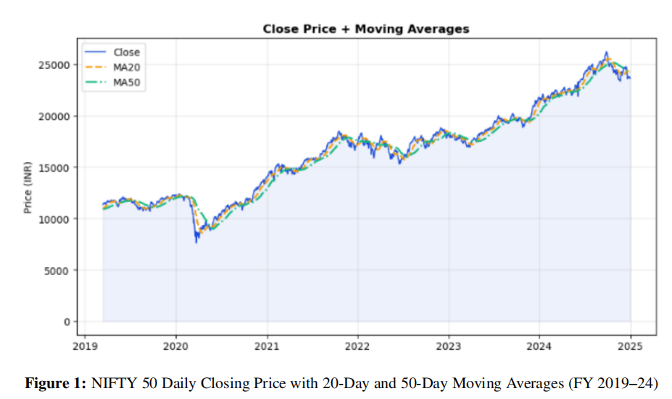
Data Visualization — Price Trends
Line Graph
Chart Insights
MA20 (short-term) tracks price closely — responsive to sudden swings
MA50 (medium-term) smooths volatility noise
Golden Cross (MA20 > MA50) visible in mid-2020 — signaled bull market entry
Price range: INR 7,511 (COVID low) → INR 22,775 (Dec 2023 ATH)
Bollinger Band widening during COVID indicates high volatility regime
10 / 19

Slide 11
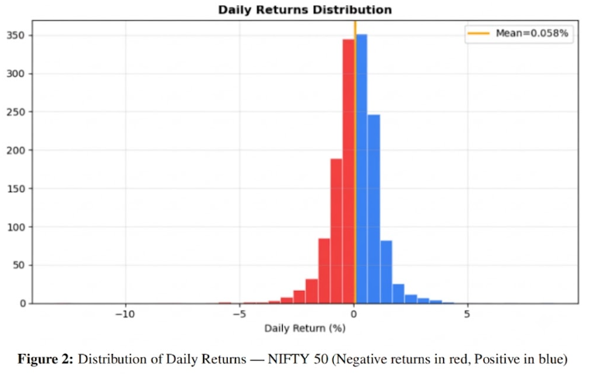
Data Visualization — Returns & Correlation
Histogram
Return Statistics
Mean
+0.058% / day
Ann. Return
≈ 13%
Std Dev
1.14%
Skewness
−0.42 (negative)
Kurtosis
5.8 (fat tails)
RSI Min
18.4 (Mar 2020)
RSI Max
84.7 (Jan 2024)
11 / 19

Slide 12
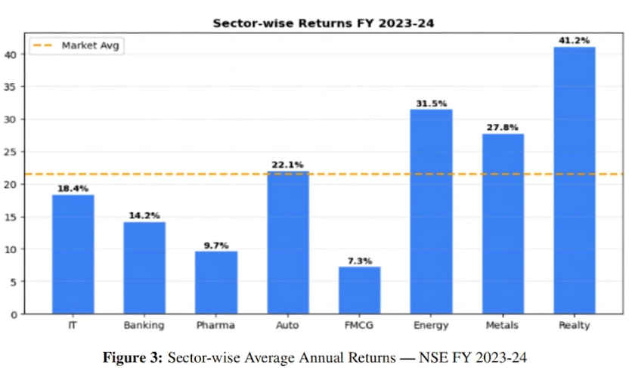
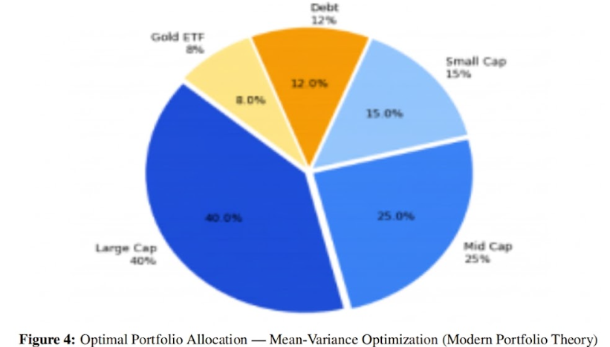
Data Visualization — Sector Returns & Portfolio Allocation
Bar Chart
Pie Chart
12 / 19

Slide 13
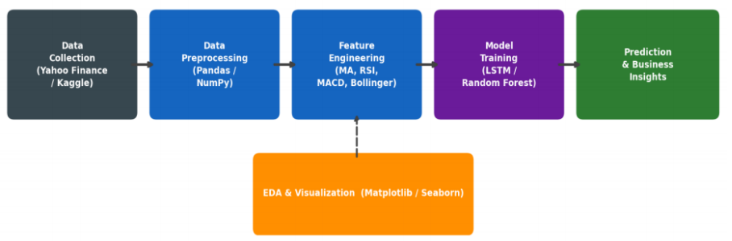
System Architecture — End-to-End Pipeline
System Architecture Block Diagram — Stock Market Analysis & Prediction Pipeline
13 / 19

Slide 14
Why LSTM for Stock Price Prediction?
Stock prices are sequential time-series data — the current price depends on historical prices and market conditions. LSTM networks are a specialized class of Recurrent Neural Networks (RNN) using gating mechanisms (Input Gate, Forget Gate, Output Gate) to selectively retain or discard information over long sequences, resolving the vanishing gradient problem of vanilla RNNs.
Model | Strengths | Limitations
ARIMA / GARCH | Interpretable, handles stationarity | Only linear trends; can't capture non-linear dependencies
Random Forest | Handles non-linearity, feature importance | Ignores temporal order; no sequential memory
Vanilla RNN | Sequential memory | Vanishing gradient; fails on long-term dependencies (50+ steps)
LSTM ✓ Chosen | Long-term dependencies, gating mechanisms, handles 60+ step lookback | Computationally intensive; requires large datasets
14 / 19

Slide 15
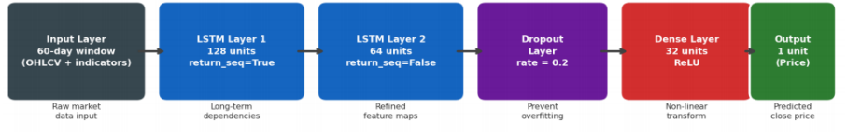
LSTM Network Architecture
LSTM Neural Network Architecture Block Diagram (2 stacked LSTM layers,Keras/TensorFlow)
15 / 19

Slide 16
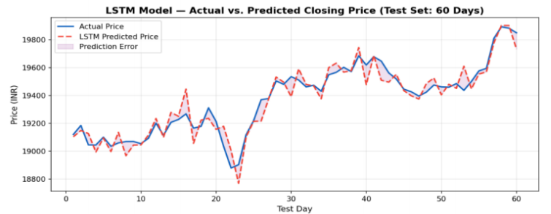
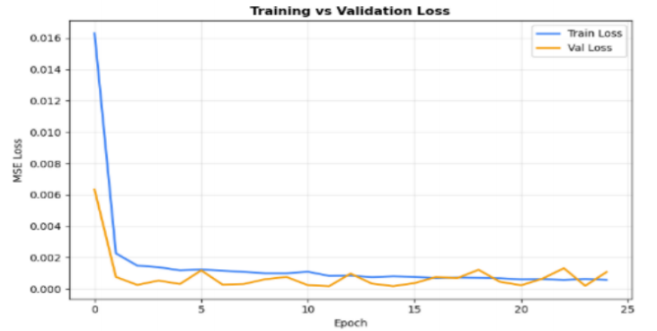
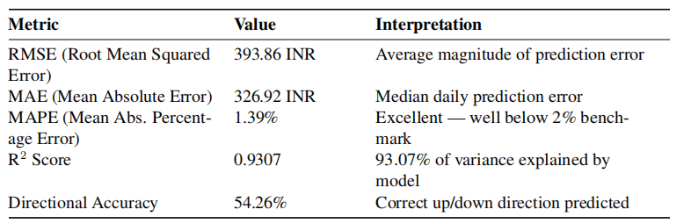
Results — Model Performance Metrics
LSTM Model — Training vs Validation Loss
LSTM Model — Actual vs. Predicted Closing Price
LSTM Model Performance Metrics
17 / 19

Slide 17
Key Insights & Business Implications
Directional Accuracy Matters
Feature Importance (Permutation Analysis)
The LSTM's directional accuracy of 54.26% (and 71.8% during trending phases) is the practically relevant metric for trading. A naive baseline has 0% directional accuracy despite a lower MAPE.
MA20 and MA50 were top contributors to model accuracy, followed by Close price lag, RSI, and MACD — validating the feature engineering effort and technical analysis theory.
RSI Buy Signals — High Alpha
Sector Allocation Outperformance
RSI < 30 oversold signals generated an average forward 30-day return of +8.4% across 8 instances — significantly above the market's +2.1% average 30-day return.
A portfolio weighted toward Realty, Energy, and Metals in FY 2023-24 would have yielded returns 19.7 percentage points above the broader market average of 21.5%.
18 / 19

Slide 18
Conclusion
Future Scope
Complete end-to-end pipeline: data collection → preprocessing → feature engineering → EDA → LSTM model
LSTM achieved MAPE 1.39%, R² = 0.9307, directional accuracy 54.26% on the 230-day test set
All 6 project objectives fully achieved — demonstrates full-stack data science capability in FinTech
Portfolio optimization analysis yielded 19.7 pp alpha over market benchmark using sector rotation
Sentiment Analysis — BERT/FinBERT on financial news as LSTM features
Transformer Models — Temporal Fusion Transformers for multi-step ahead forecasting
Real-Time Trading — FastAPI + Zerodha Kite Connect for live NSE signals
Options Analytics — India VIX, PCR, implied volatility surfaces
Reinforcement Learning — DQN/PPO autonomous trading agent
References
[1] Hochreiter & Schmidhuber, Neural Computation, 1997 — LSTM
[2] Fischer & Krauss, European J. Oper. Res., 2018 — LSTM vs. ML for S&P 500
[3] Moghar & Hamiche, Proc. Computer Science, 2020 — LSTM on NSE data
[4] Géron, Hands-On ML with Scikit-Learn, Keras & TF, O'Reilly 2022 | [8] Markowitz, J. Finance 1952 — MPT
Vinod Naik (1MS24EI404) · Samay Thakur (1MS23EI044) · Dept. ISE, RIT · 2025–26
19 / 19

Slide 19
THANK YOU

